Slide 1
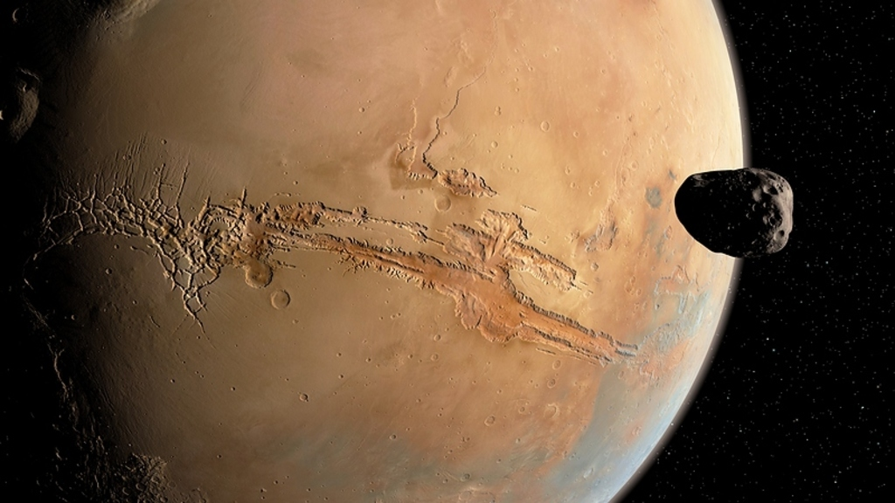
My Planet
Ariel Kitch

Slide 2
Physical Features
My sentence about the physical features of my planet.

Slide 3
Why Visit Planet?
My sentence about why you should visit my planet.

Slide 4
My Favorite Thing About My Planet
My sentence about my favorite thing about my planet.

Slide 5
Conclusion
My sentence to wrap up my presentation.

